Slide 1
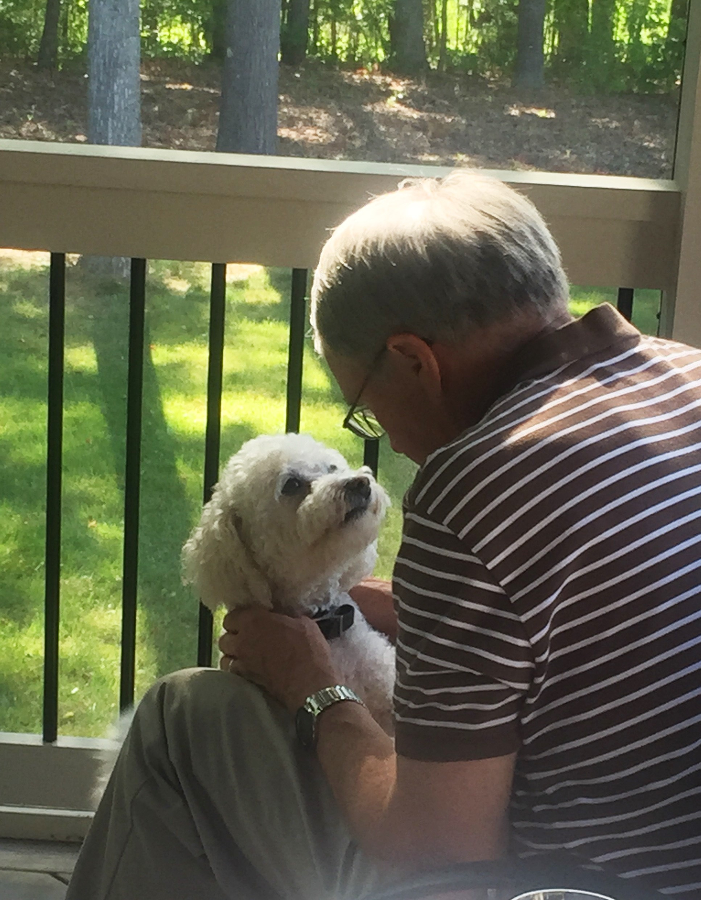

A Conversation About High Speed Broadband!
Our dog Zack!

Slide 2
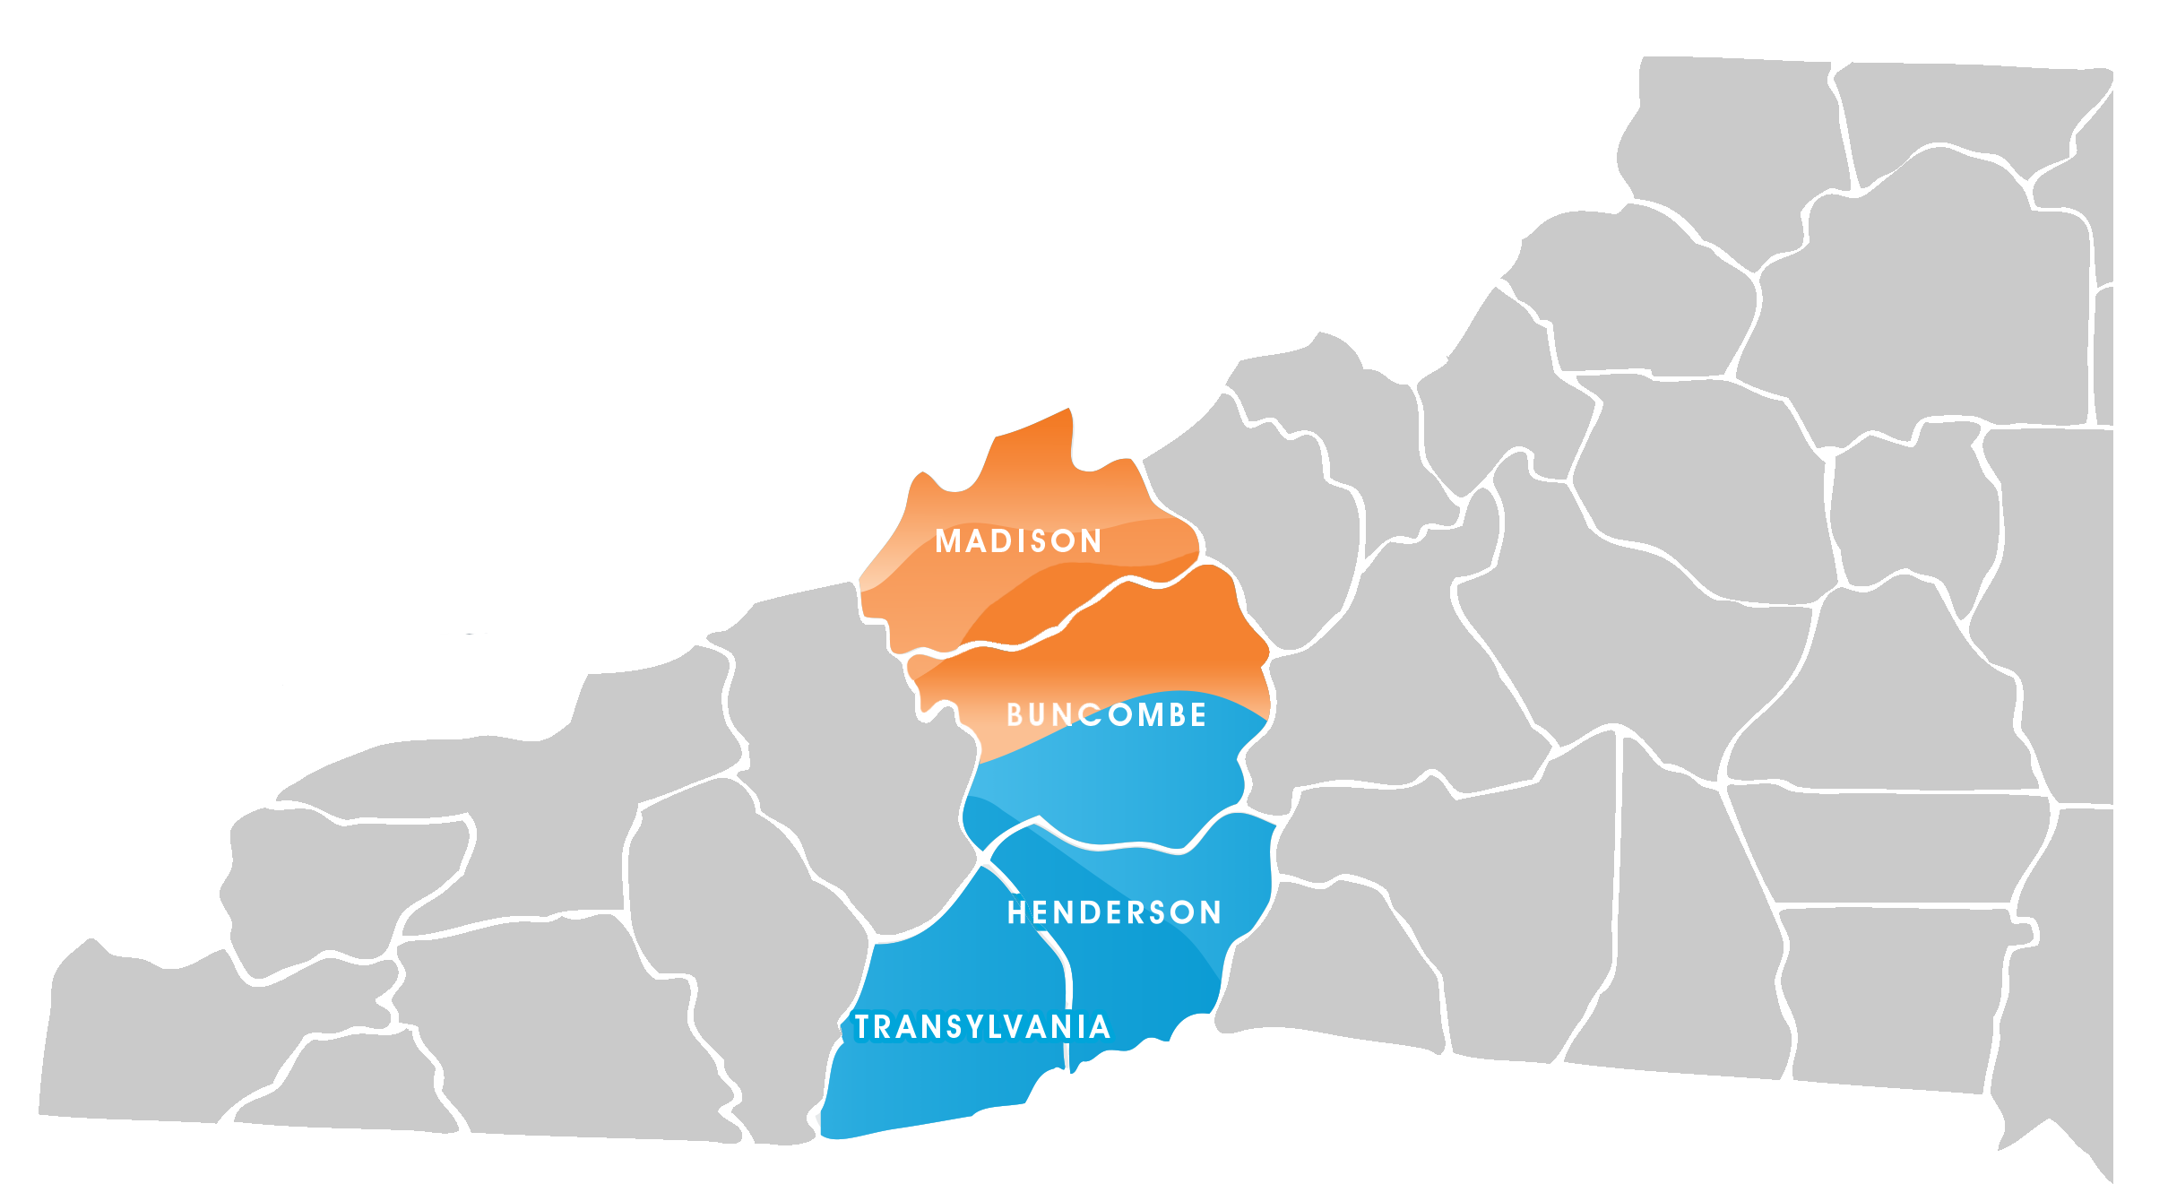

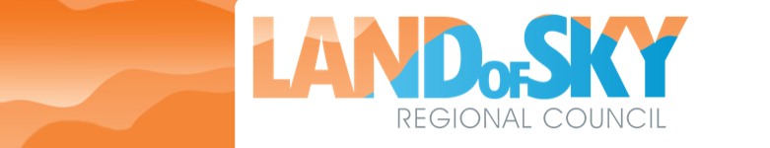
Using NGN Model in Western North Carolina
Creating a public – private partnership under auspices of Land of Sky Regional Council

Slide 3

Four Observations + Bonus!
Broadband literacy is useful
Gigabit speeds are needed
Private/Public Partnership is the “model” to use
West Next Generation Network initiative is “happening”
Bonus: What you can do & conversation
But first - who we are!

Slide 4


Self introduction:
MSU Grad – married with 2 grown children
Michigan State Senator (R- East Lansing)
University President
Ferris State University
Utah Valley University
UNCW Interim Chancellor
Utah Commissioner of Higher Education
Retired to Enka, NC in 2012
OLLI Member Since 2012
Michigan State
Vs
Michigan
Oct. 20

Slide 5
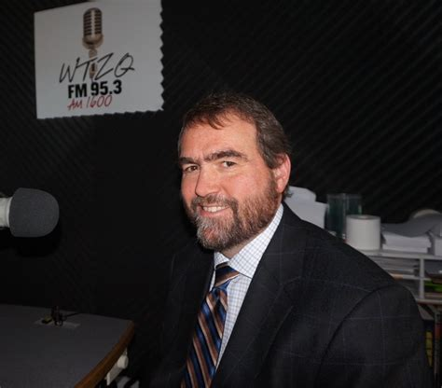
Dr. Michael Dempsey
Dean of Lenoir-Rhyne University's Center for Graduate Studies of Asheville.
12 years as director of community partnerships for A-B Tech
Member, Board of Directors for the Martin Luther King, Jr. Association of Asheville/Buncombe County and the Raphael Guastavino Museum.
Degrees in philosophy, history, and educational leadership.
Mike, explaining the wonders of gigabit network speed to the media.

Slide 6
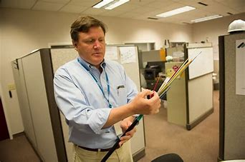
Mr. Hunter Goosmann
Executive Director and Chief Executive Officer of the Education & Research Consortium of the Western Carolinas, Inc (ERC, dba ERC Broadband)
Board of Directors for the North Carolina Technology Association, the Board President of the Bob Moog Foundation.
He is also currently an adjunct professor of Management at UNCA, photographer, soccer referee, and guitarist.
Hunter, counting his fiber strands!

Slide 7
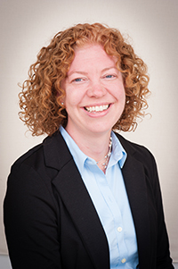
Ms. Erica Anderson
Director of Economic and Community Development – Land of Sky Regional Council
Responsible for planning for land use, conservation, water management, transportation and GIS systems (among others)
Master of Urban and Regional Planning, Virginia Polytechnic Institute and State University

Slide 8

Observation 1: Public understanding of broadband is fundamental to our “success.”
One computer to another through packet switching.
ARPANet four computers connected
Vincent Cerf and network Transmission Control Protocal (HTTP)
1965
1969
1970s

Slide 9
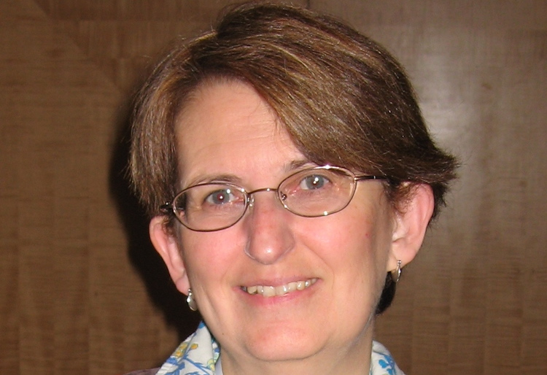
Observation 1: Public understanding of broadband is fundamental to our “success.”
One computer to another through packet switching.
ARPANet four computers connected
Vincent Cerf and network Transmission Control Protocal (HTTP)
Jean Armour Polly – Librarian U. of Minn. 1992
AKA “Net Mom”
1965
1969
1970s

Slide 10
Observation 1: Public understanding of broadband is fundamental to our “success.”
One computer to another through packet switching.
ARPANet four computers connected
Vincent Cerf and network Transmission Control Protocal (HTTP)
Telephone modems & bulletin boards
1965
1969
1970s
1980s

Slide 11
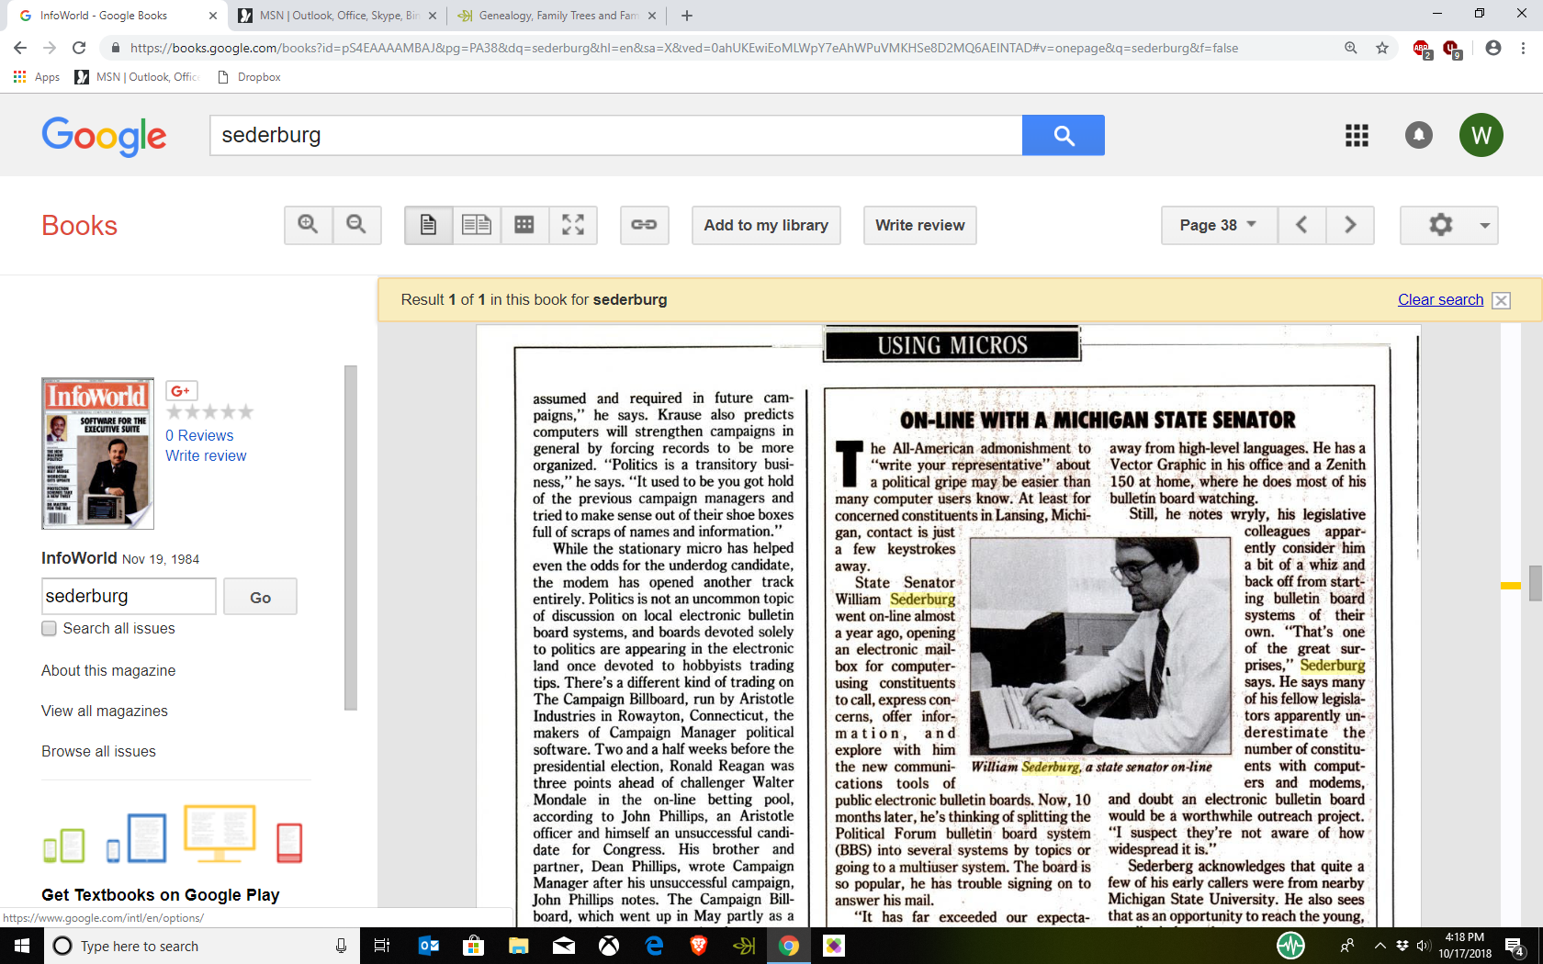
Nations first legislative “on line constituent service” and state hearing on a computer bulletin board system
One computer to another through packet switching.
ARPANet four computers connected
Vincent Cerf and network Transmission Control Protocal (HTTP)
Telephone modems & bulletin boards
1965
1969
1970s
1980s
1990’s
2000’s

Slide 12
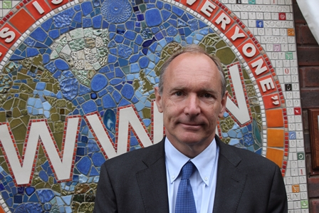
Observation 1: Public understanding of broadband is fundamental to our “success.”
Sir Timothy John Berners-Lee
One computer to another through packet switching.
ARPANet four computers connected
Vincent Cerf and network Transmission Control Protocal (HTTP)
Telephone modems & bulletin boards
World Wide Web using hypertext transfer protocols
1965
1969
1970s
1980s
1990’s

Slide 13
Observation 1: Public understanding of broadband is fundamental to our “success.”
One computer to another through packet switching.
ARPANet four computers connected
Vincent Cerf and network Transmission Control Protocal (HTTP)
Telephone modems & bulletin boards
Tim Berners-Lee invented World Wide Web
Phone lines split into “Broadband” carriers – wire and wireless
1965
1969
1970s
1980s
1990’s
2000’s

Slide 14

And the race was on!
Medium of transmission –
Coaxial Copper Cable - traditional cable TV
Twisted Pair Copper Cable – Digital Service Line (DSL) – AT&T Uverse
Optical Fiber – glass fibers (human hair size)
Speed of light
Huge capacity
Doesn’t “degrade” easily
Easy maintenance
Wireless – 4G and soon 5G WI-FI (fifth generation)

Slide 15

Observation 2: Gigabit speeds are needed.
Network to carry the transmission close to customer
+
Demand to drive business opportunities
Regional Vision Profile

Slide 16
Digital Factoids
The digital universe consisted of 281 exabytes (281 billion Gigabytes) in 2007
45 GB for EVERY person on the planet
The amount of information created, captured or replicated exceeded available storage for the first time in 2007 (info is email, images, phone calls, social media, just plain ole data !!)
Global IP traffic reached 1 Zettabyte in 2016 and will triple by 2021 to 3 ZB
1,000,000,000,000 Gigabytes = 1 Zetabyte / 5 Exabytes = all words ever spoken by humans
(DVD, RFID, Digital TV, MP3, Digital Cameras, Camera Phones, VOIP, Medical Imaging, Laptops, Games, DataCenter Applications, GPS, Satellite Images, Scanners, ATMs, Sensors, Digital Radio, Email, Instant Messaging, Video Conferencing, Security Systems, CAD/CAM, Appliances)
YouTube used as much bandwidth in 2007 as the entire Internet in 2000
As of Oct 2018 there are 1.9 billion + websites on the Internet
Almost 4 million photos are uploaded to Instagram and 250 billion emails sent daily
4 billion (out of 7 billion on earth) are online
The result of this growth is the installation of 100 Gigabit equipment (which grew by 450% in 2016)

Slide 17
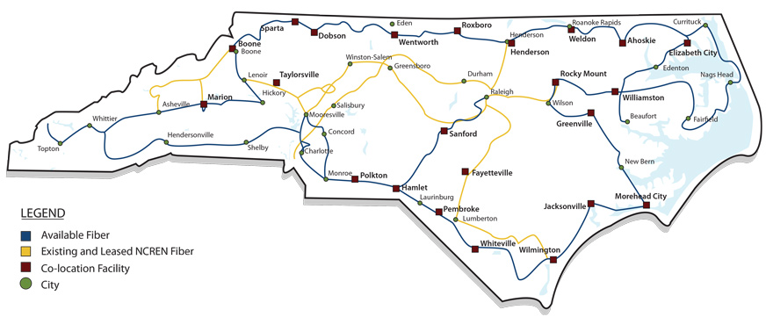

What Drives Growth
3 digital conversions (1) images, (2) voice, and (3) IPTV / video
What middle mile networks carry this traffic in North Carolina ?

Slide 18
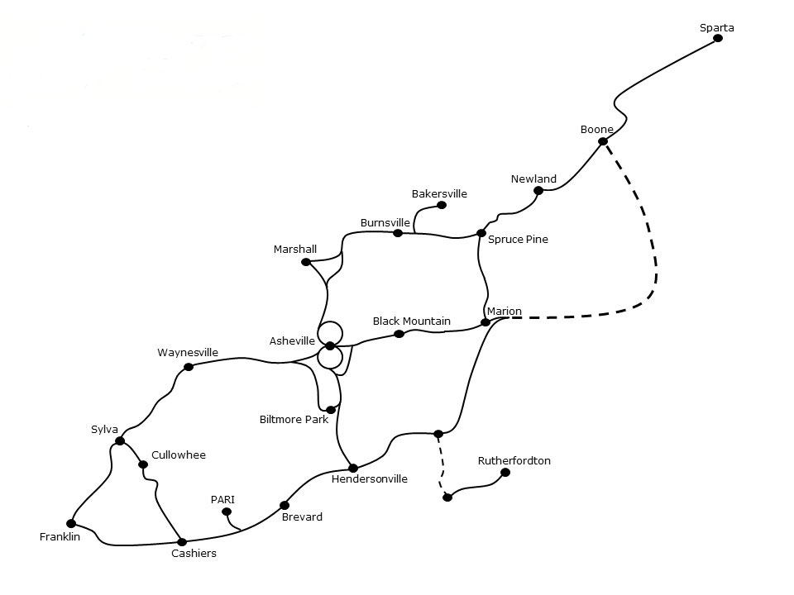

How will we reach rural communities ??
“Old” copper wiring
Wireless (P2P)
Fiber Optic Cable
Cellular (5G)

Slide 19
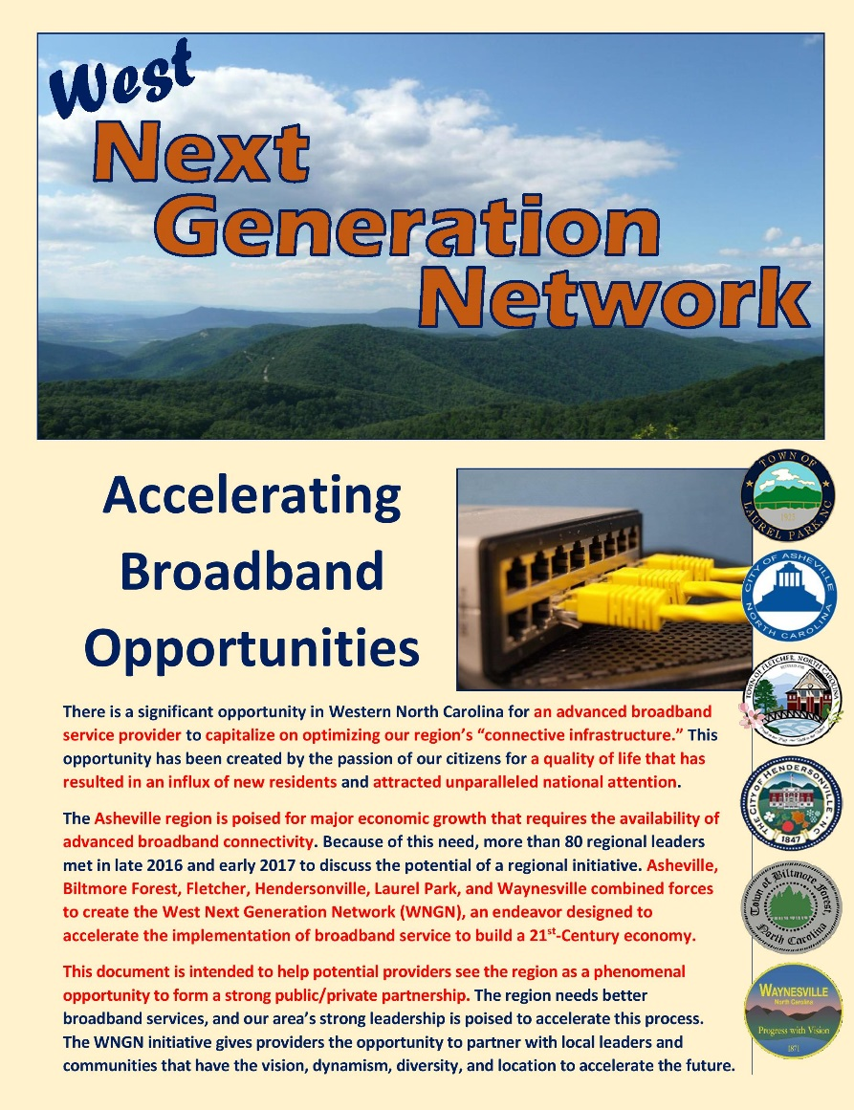
Observation 2: Gigabit speeds are needed.
Regional Vision Profile
University team
Dr. Mike Dempsey
Dr. Ed Katz
Graduate Students

Slide 20
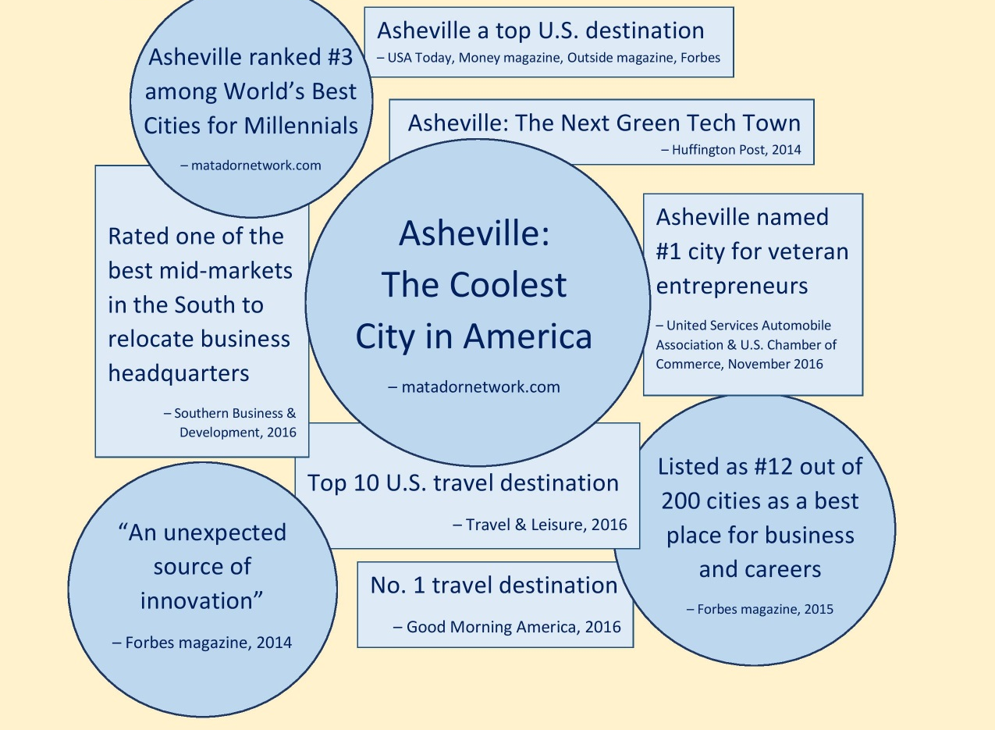
A Place People Want to Be

Slide 21

An Area Poised for Success

Slide 22

Education
High-speed internet is needed to boost learning
Increased delivery of content.
Streaming capabilities that connect students and increase access to learning resources.
More collaboration with artists, scientists, statisticians, and other experts in remote areas.
Heightened capabilities for students to access homework online.

Slide 23
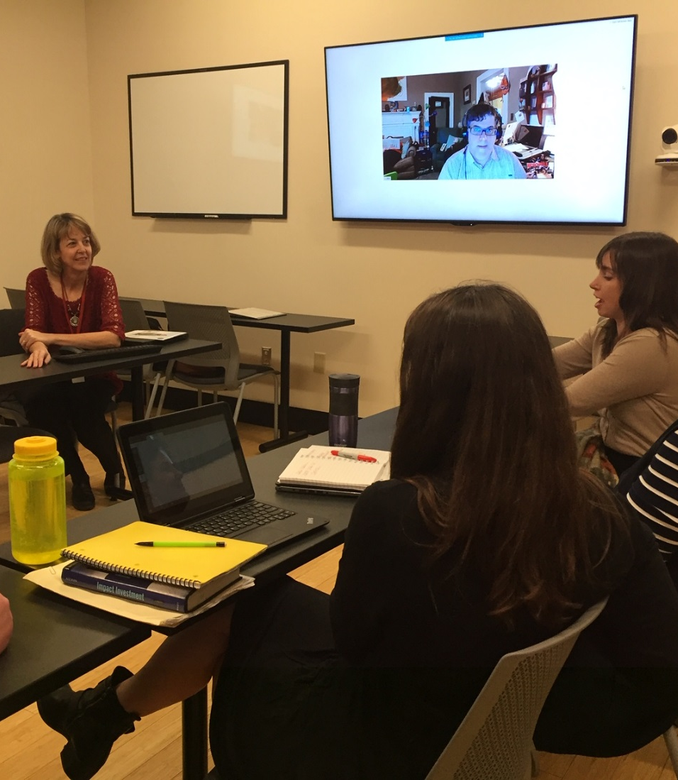
Improves effectiveness of instruction through more engaging, interactive activities.
Encourages innovation in how education is delivered, including hybrid approaches to teaching.
Allows students to engage in activities that refine and extend technical skills.
Facilitates the collection and analysis of greater amounts of student-performance data.
A MBA in Social Entrepreneurship class meets at Lenoir-Rhyne University’s Asheville campus.

Slide 24
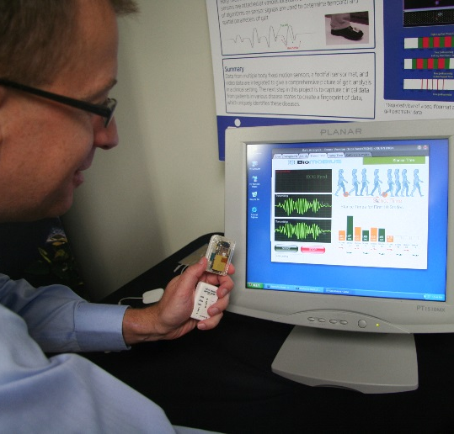
Healthcare
Advanced broadband strengthens medical services
Real-time transmission of medical imagery enables the interpretation of diagnostics to be performed remotely.
Patient visits can be reduced through remote monitoring, online consultations.
Broadband allows physicians to connect with distant specialists for real-time guidance in emergency situations.

Slide 25
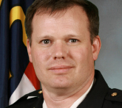
Government
Broadband = Efficiency, public safety, better value
Extensive broadband is a prerequisite to creating a “smart city.” “Smart cities” collect, analyze, and communicate data to enhance sustainability livability, and workability. Information is collected through sensors and other devices. The data are “crunched” to understand current situations, as well as to predict future occurrences.
Energy
Smart electrical grid & energy planning Electronic metering of homes, businesses Strategies for renewable energy management
Safety and Security
Integrated operations centers Lighting efficiencies Public transportation route management Electronic security systems
Health
Telehealth monitoring in the home Telecare via video conferencing Mobile clinical assistance
Transportation
Supply chain and logistics management
“Our first responders stake their safety daily on the ability of large amounts of information to be communicated immediately during difficult situations.”
Scott Burnette, City of Asheville Fire Chief

Slide 26
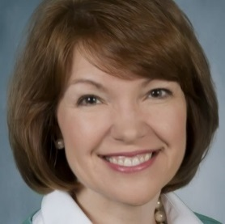
Tourism
Service providers & visitors crave better access
Broadband-supported virtual reality plays a key role when tourists access information about museums, hotels, restaurants, and events.
Allows conference speakers and attendees to simultaneously access internet during large meetings and presentations.
Expands marketing opportunities that allow hoteliers and other industry experts to utilize state-of-the-art software programs that are instrumental for growing their businesses.
Improves the quality of industry services, particularly in the area of cloud-based software systems.
“Meetings mean business in Asheville and broadband is essential for successful group events. High-speed connectivity is a requirement for today’s technology-intensive tourism industry, which generates revenue for local businesses and supports 27,000 jobs in Buncombe County.”
Stephanie Pace Brown, CEO, Explore Asheville

Slide 27
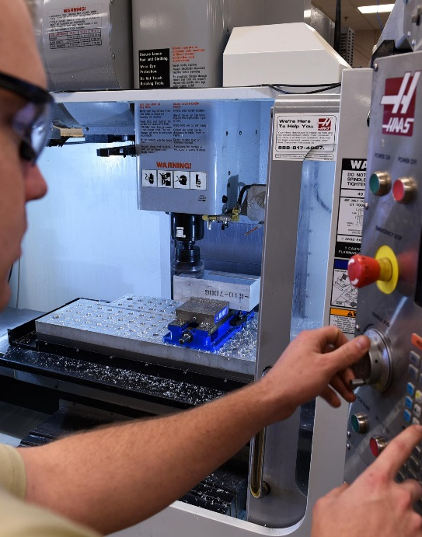
Advanced Manufacturing
Efficiency will be maximized with broadband’s help
Respondents to a survey distributed to WNC manufacturers indicated broadband would serve them by:
Allowing for greater efficiency in customer service
Providing access to online training for remote workers
Increasing the speed of business and responsiveness
Improving logistics by serving needs of global consumers
Automating sales processes, due to increased availability of real-time customer data and reduced response time
Boosting remote access to assembly lines and machines
Attracting a younger workforce well-versed in technology

Slide 28
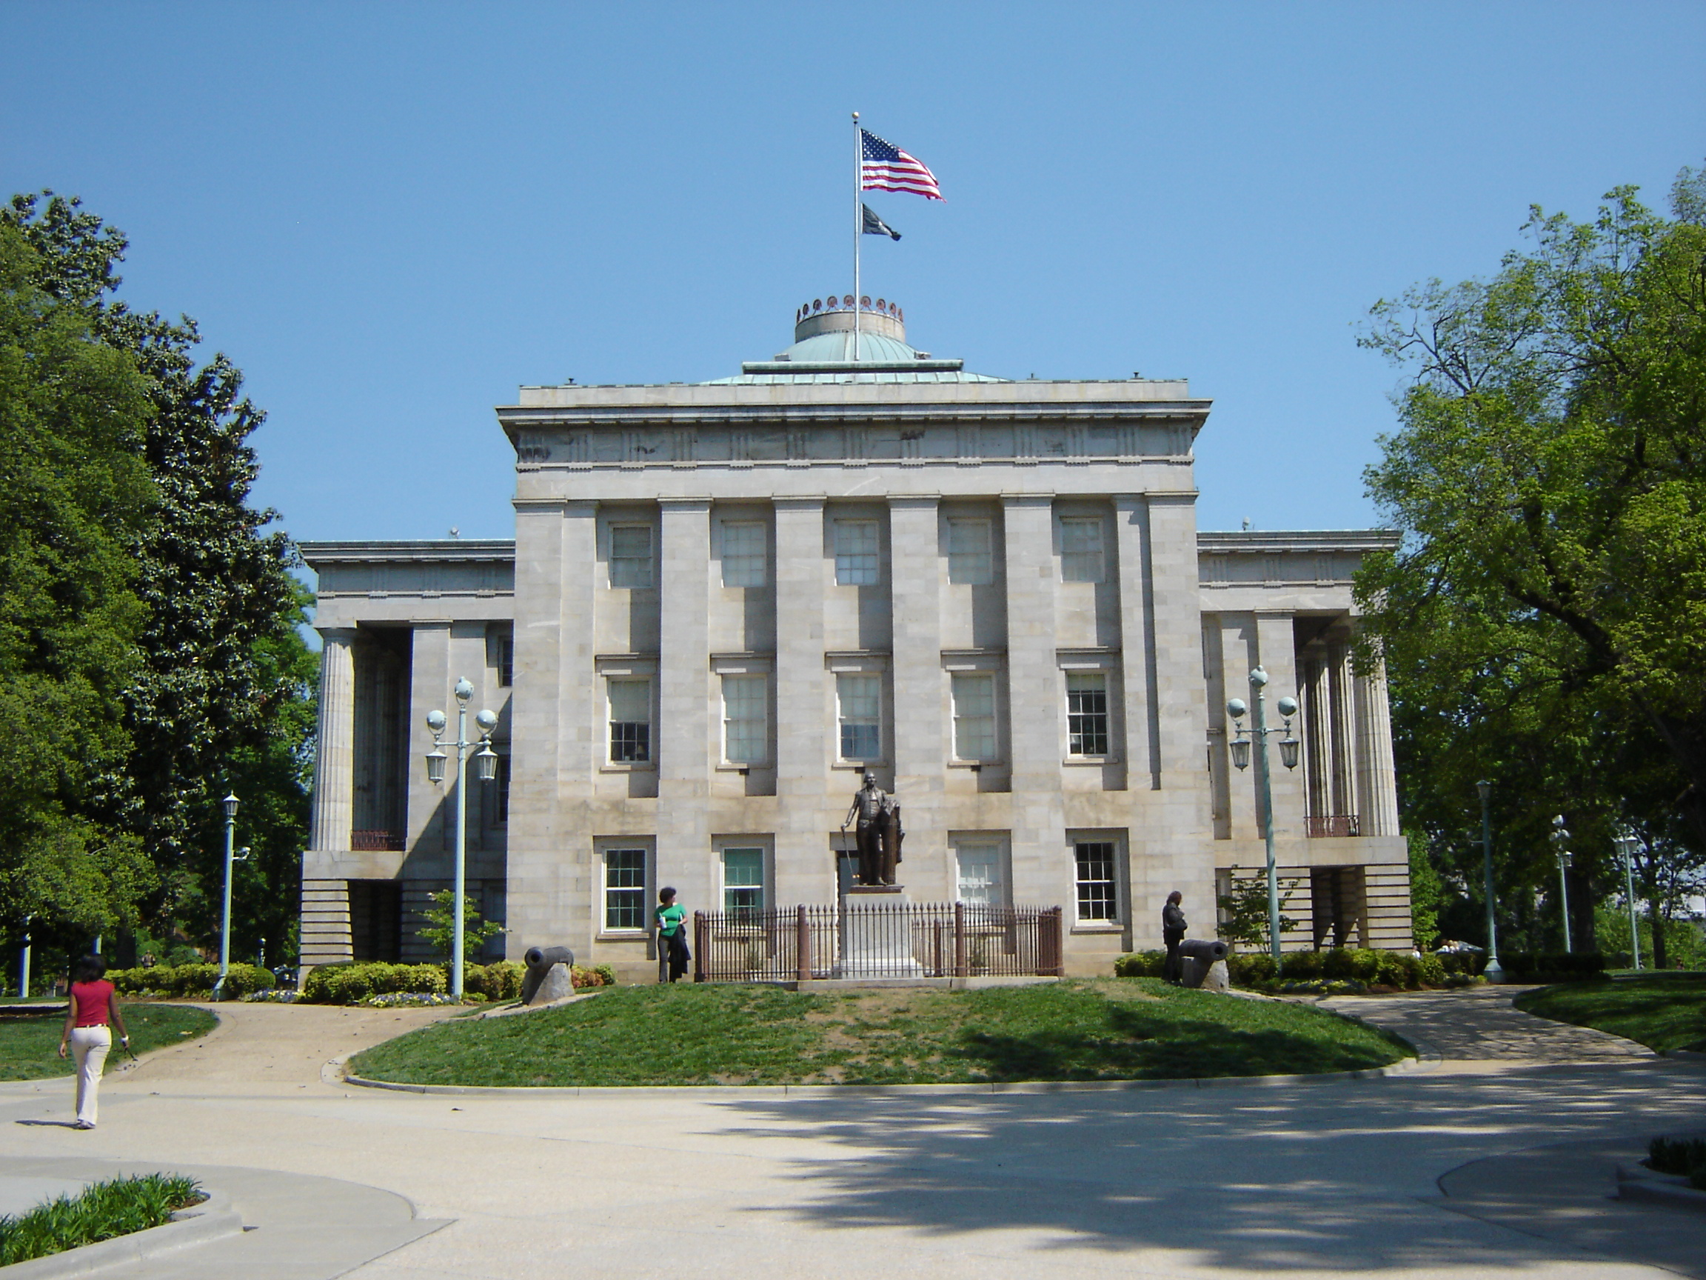
Observation 3: Gigabit service requires effective public/private partnerships!
Multiple players in the broadband “space.”
Government –
Schools, Universities
Transportation
Cities/counties
Planning councils
Private –
Backbone carriers
Service providers (At&T, Charter, etc.)
NC Legislature bans counties & cities from providing customer broadband services directly.

Slide 29
Observation 4: Our regional response is the West Next Generation Network initiative!
Leveraging current assets to build a strong public/private partnership

Slide 30
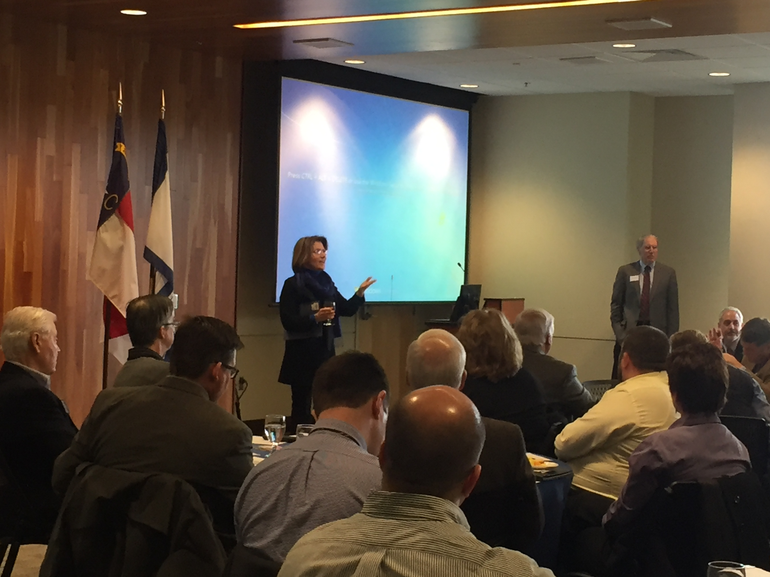
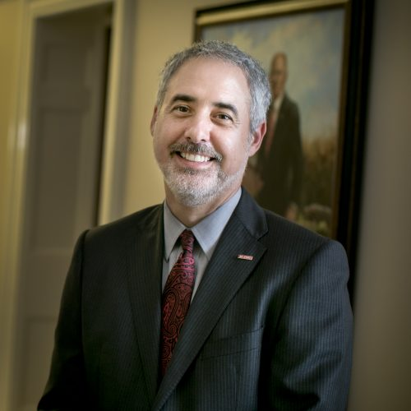
Steering Committee
Bill Sederburg - Hub
Hunter Goosmann - ERC
Ed Katz - UNCA
Erica Anderson- LOS
Otis Brown – NCSU
Corey Atkins– AVL Chamber
AVL Hub Executive Committee
Janice Brumit
Jack Cecil
Pat Smith
Mack Pearsall
Mary Grant
#1
Two leadership fora with Dr. Marc Hoit, NCSU Chief Information Officer!

Slide 31
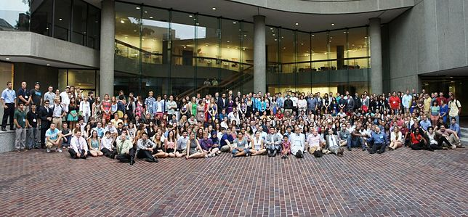
Leadership Interest
Mayors
Council Members
County Commissioners
College Chancellors
School Superintendents
Economic development leaders
Many others …
Faux representation of leadership interest!
Mayor Manheimer, Mayor Volk, Commission Chair Newman, LOS Director Hembree, Supt. Baldwin, Chancellor Grant and many others.

Slide 32
Gigabit speeds will ultimately be offered in the region at reasonable cost.
The issue is moving the region ahead of others for investment.
NGN Strategy without a big pot of money!
Reduce Cost
Assist Utilization
Private Sector Engagement

Slide 33
WNGN - Two Phases
Phase 1 – Urban areas along fiber networks with available “dark fiber”
Asheville, Waynesville, Hendersonville, Fletcher, Laurel Park & Biltmore Forest
Excluded a number of interested communities & areas

Slide 34
Six communities created West Next Generation Network (WNGN)
Hendersonville
Asheville
Laurel Park
Land of Sky Regional Council
Biltmore Forest
Fletcher
Waynesville
Along fiber optic backbone!

Slide 35
Cost & Convenience
Utilization
Request for Negotiations
Regional Vision Profile
Erica Anderson – Land of Sky
John Connet – Hendersonville
Jonathan Kanipe – Biltmore Forest
Alyson Alexander - Laurel Park
Mark Biberdorf - Fletcher
Jonathan Feldman – Asheville
Jon Feichter – Waynesville
University team
Dr. Mike Dempsey
Dr. Ed Katz
Graduate Students

Slide 36


Resulted in 2 New Providers in Region
RiverStreet – Wilkesboro Telecom Cooperative
Interested in connecting Saluda with Barnardsville
Payback requirements allow more rural strategy
Hotwire – new to North Carolina
Interested in partnering with governments creating their own networks
Big gigabit provider in Florida and 6 other states

Slide 37
Current status
Hotwire
On hold until new city and county managers are appointed.

Slide 38
Current status
RiverStreet – public conversation
Dec. 4 – 10 AM Biltmore Forest Town hall
Dec. 4 – 6 PM Fletcher Town Hall
Dec. 5 - 6 PM Hendersonville Town Hall
Dec. 5 - 10 AM Laurel Park Town Hall

Slide 39
WNGN - Two Phases
Phase 2 – Less urban areas in Land of Sky service region (Henderson, Transylvania, Buncombe & Madison Counties)
Planning grant from Appalachian Region Commission (ARC)
Inclusive strategy

Slide 40

Phase 2: Building regional collaboration
Conversation with regional leaders about what we need to do
Appalachian Regional Commission Grant
Utilize Phase 1 work
Analyze current situation
Vertical assets
Fiber assets
Identify pressing needs

Slide 41
What you can do.
Participate in WNGN Surveys
Assist with usage study in partnership with UNCA
Convey your support to local and state leaders

Slide 42


